Slide 1
Hullolens 2 Recap
Benjamin Allison

Slide 2
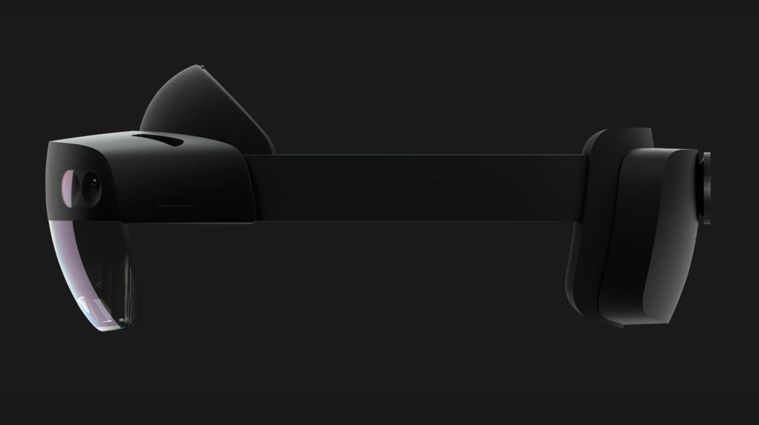
Notes:
Hullolens 2 was announced on 24th of February 24th (My birthday its fate) at the mobile wold congress in Barcelona
It predecessor the Hololens came out 2016 and the Hullolens 2 has set out to improve in many ways

Slide 3

Notes:
What is it?
‘ullolens 2
Snapdragon 850 SoC
Updated HMU (holographic processing unit)
2k per eye
Increased fov – 47 pixels per degree from 23, increased by 2x
Improved sensor array, now includes iris sensor
Gaze and windows hello, foveated rendering
Front enclosure made of carbon fibre
Single band for increased comfort, battery on the back
‘3x times more comfort’ what does that even mean
Weighs 566g, as opposed to 579g
$3500 it’s a steal

Slide 4
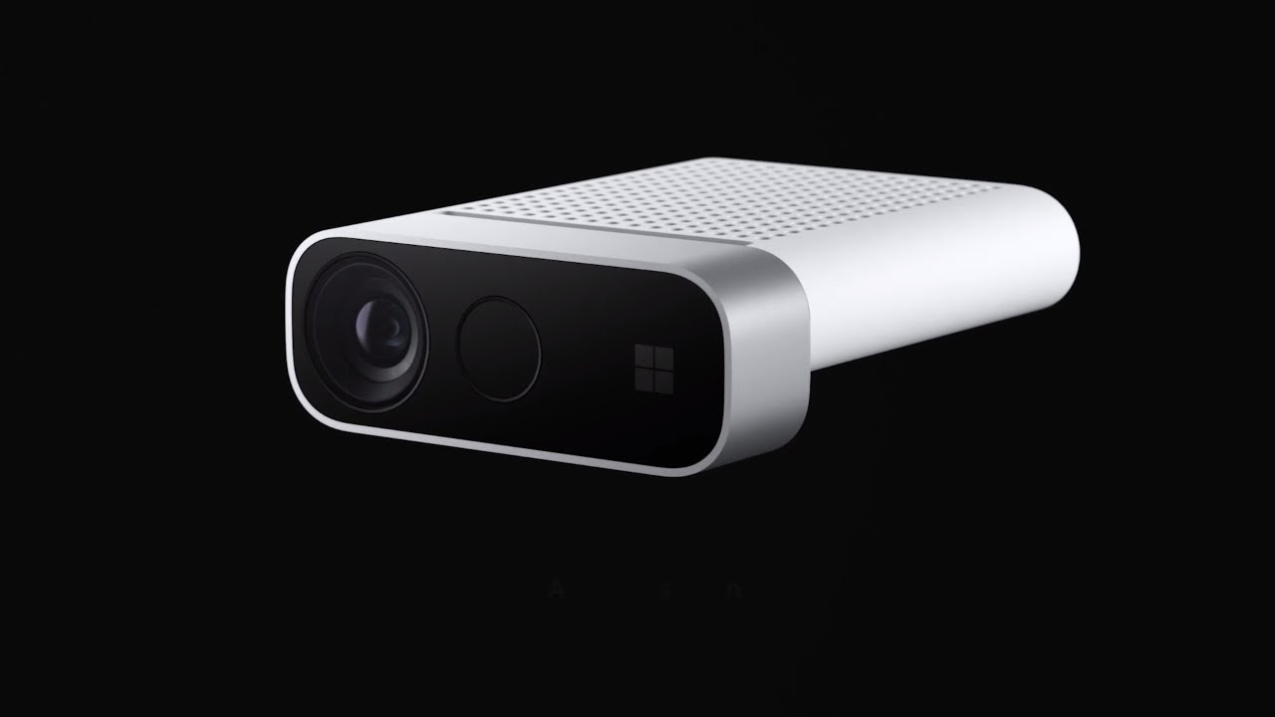
Notes:
Also a standalone product, available at $399
Increased resolution of scanning
Full hand and finger tracking
New development kit available
Part of the Azure IoT Edge
USED IN HOLOELENS

Slide 5
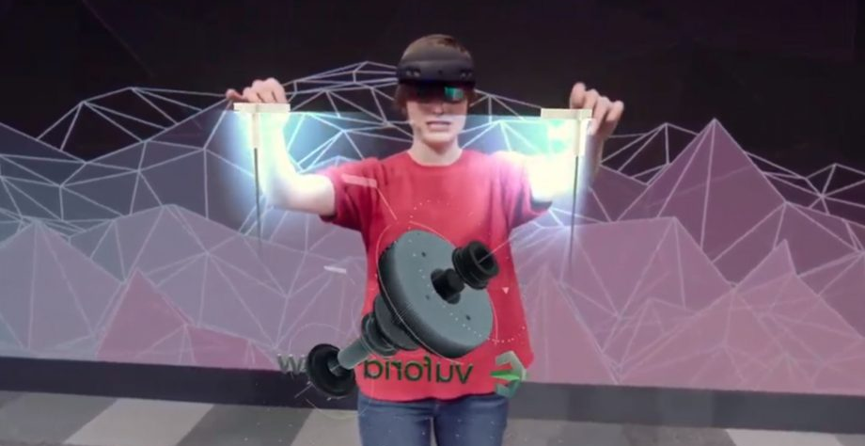
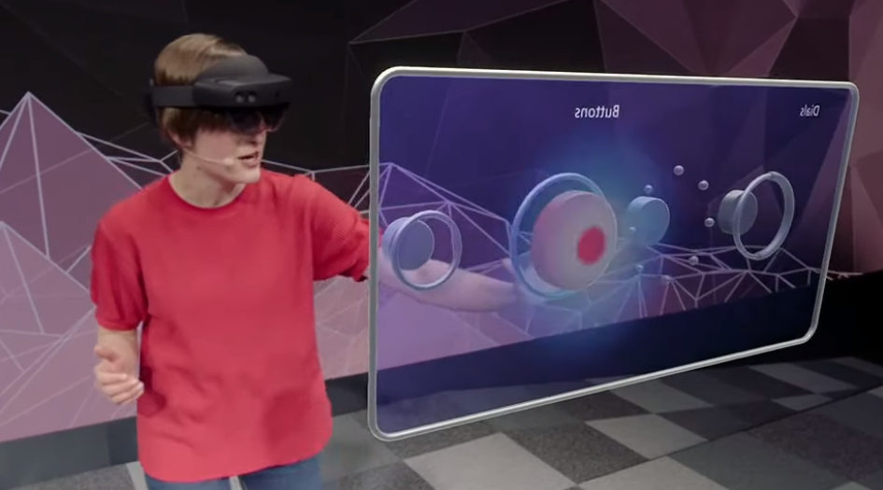
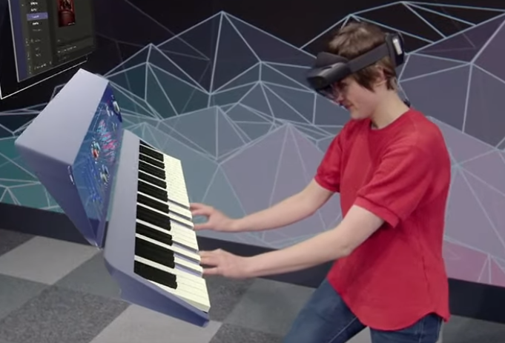
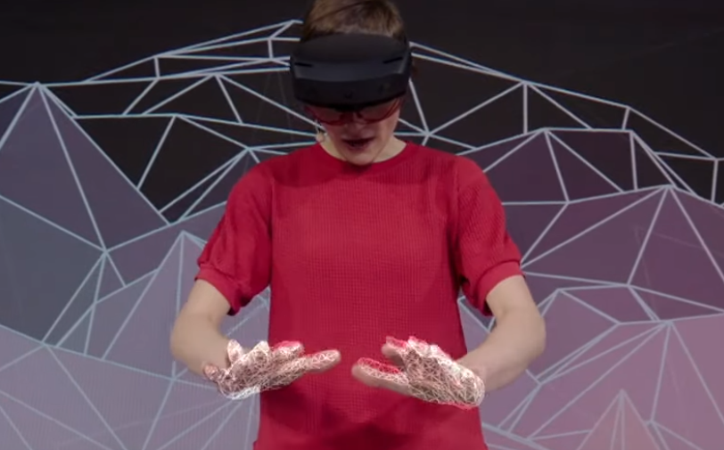
Notes:
DIRECT MANIPULATION
New gestures allow for more natural interaction with holographic content
Physically grab holograms to resize, rotate etc.
New buttons and slider introduced in Mixed Reality Toolkit to take advantage of these new features
MENU has changed
It was generally found that even though the objects aren’t real they are holographic people would treat them like real object. Small button one finger big button hand. Moving the sliders as well
Bring apps into holographic experiences

Slide 6
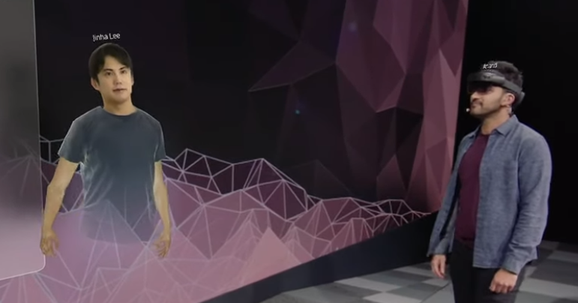
Notes:
Creates 3d avatar which can then reflect users interactions with hololens
Uses Viewforia app
Content can be added through phones and tablets, as well as in the hololens
Searching by voice presents images and 3d renders

Slide 7
Included Software
Dynamics 365
Remote assistance
Dynamics 365 guides
More software available
Notes:
step by step wizards

Slide 8
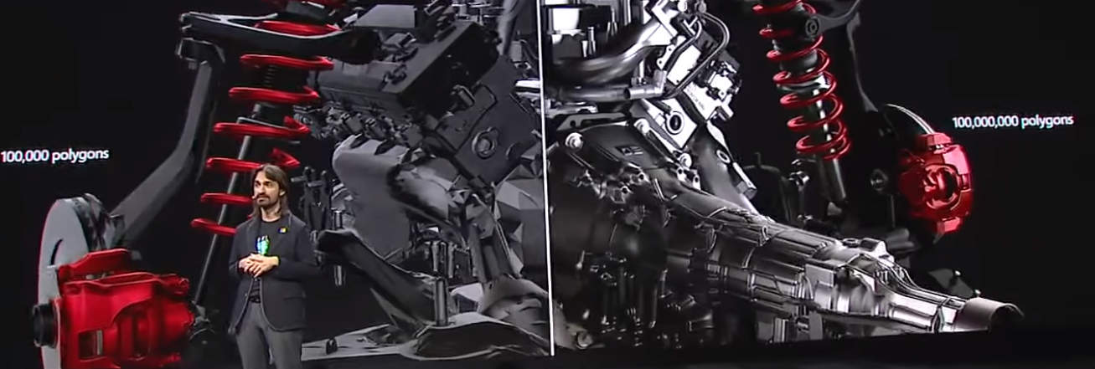
Mixed reality service suite
Azure spatial anchors
Remote rendering
Notes:
Azure spatial anchors - allow spatial data and world anchors to be sent up to azure, which can then be used by devices supporting mixed reality, ARCore or ARKit
Remote rendering – rendering can be performed in the cloud, then streamed to hololens, allowing high detail industrial models to be displayed in a high fidelity polygon count

Slide 9
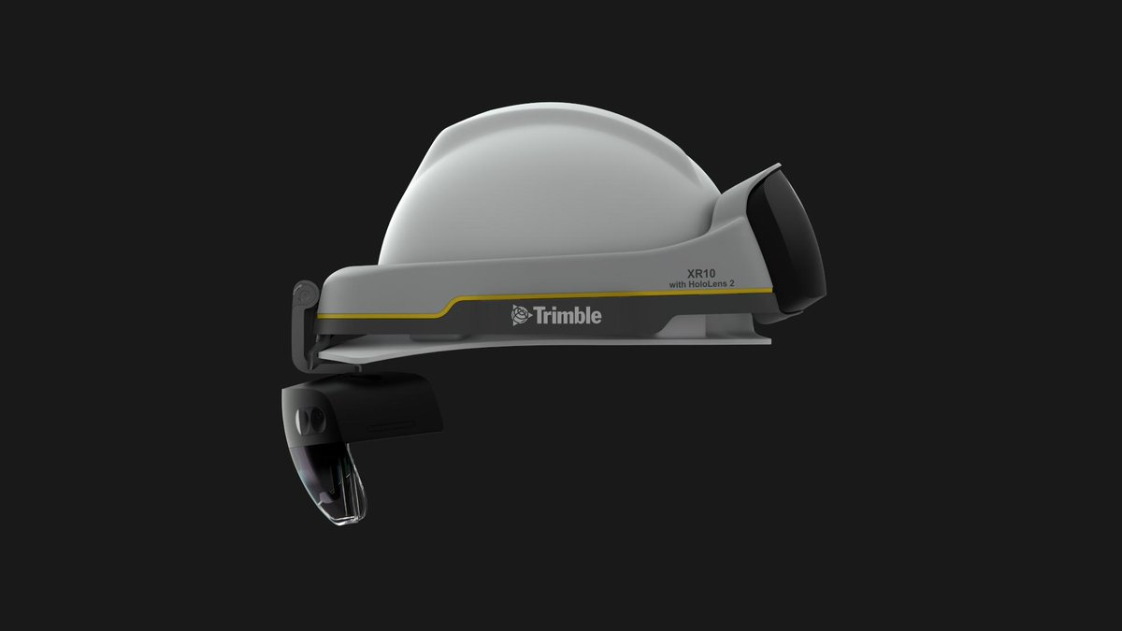
Notes:
Customisation Program
Allows hololens 2 to be customised for different form factors, such being integrated into a hard hat

Slide 10
Unity
Available development on 2018.3 and 2019.1b
2018 is the latest stable version supported, builds for 32-bit ARM
2019 is in beta, but supports 64-bit ARM builds
Mixed reality toolkit has a beta version available with support for Hololens 2 features

Slide 11

Unreal
Notes:
Unreal engine 4 will be available for developers to use for Hololens 2 development from May this year

Slide 12
Links
https://azure.microsoft.com/en-gb/services/spatial-anchors/
https://azure.microsoft.com/en-us/services/remote-rendering/
https://docs.microsoft.com/en-us/windows/mixed-reality/index#news-and-notes
https://blogs.unity3d.com/2019/02/26/hololens-2-is-coming-what-you-need-to-know/

